Slide 1
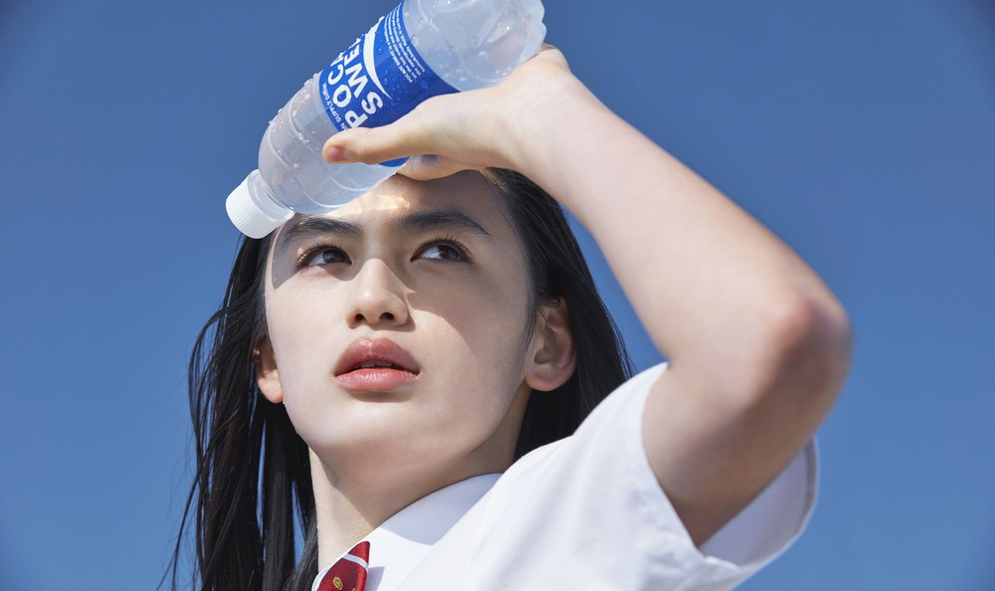

Slide 4
s

Slide 5
s

Slide 7
s

Slide 8
s

Slide 9
s

Slide 11
s

