Slide 1
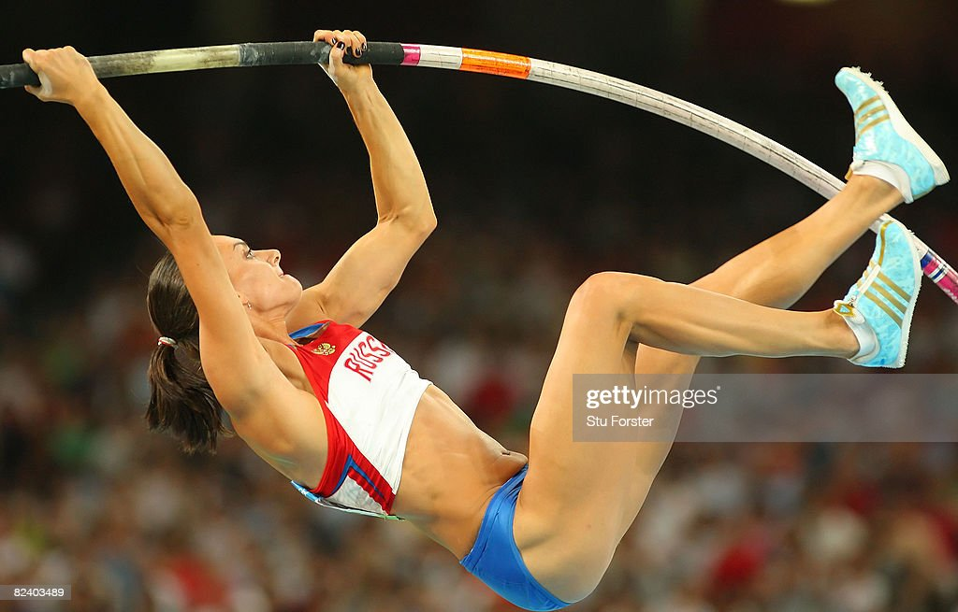
s

Slide 2
s

